Slide 1
DENV-2
UNC Brown Compounds
March 21, 2024
Simon M. Walker

Slide 2
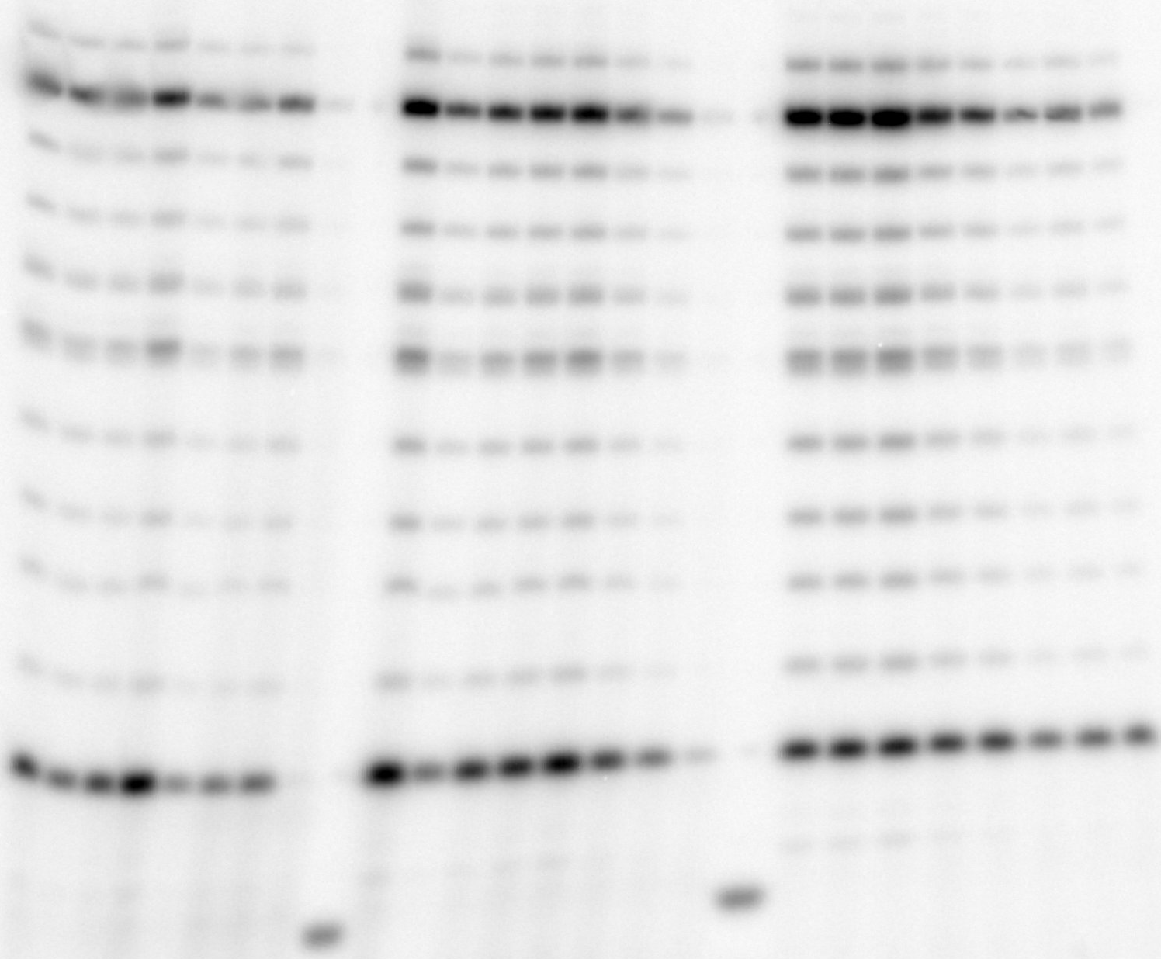
5 14
3’ UGCGCUAGAAAAAA
5’ ACGCG
Simon M. Walker
DENV-2
Primer = 200 µM; Template = 2 µM
[α-³²P]GTP = 0.1 µM; ACU mix = 1 µM
PRE-INCUBATION = enzyme + inhibitor + MgCl₂ + EDTA + Tris-buffer = 10 min, 30°C
START = Template + ACU + [α-³²P]GTP = 30 min, 30°C
UNC_p10=3
Structure not available
RA-3118, µM
RA-3272, µM
RA-3301, µM
0.14
0.41
1.2
3.7
m
0.14
0.41
1.2
3.7
m
0.14
0.41
1.2
3.7
*
0
11
33
100
0
11
33
100
0
11
33
100
14
*
13
14
12
13
11
12
10
11
9
10
8
9
7
8
7
6
6
G5
5G
4
4
Inhibition of full-template length product

Slide 3
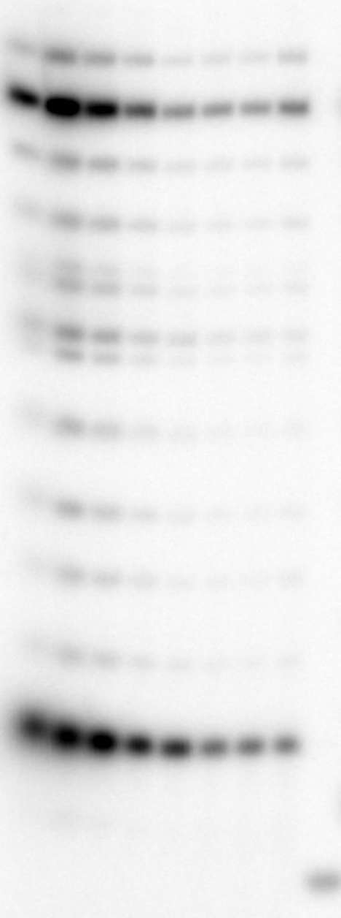
5 14
3’ UGCGCUAGAAAAAA
5’ ACGCG
Simon M. Walker
DENV-2
Primer = 200 µM; Template = 2 µM
[α-³²P]GTP = 0.1 µM; ACU mix = 1 µM
PRE-INCUBATION = enzyme + inhibitor + MgCl₂ + EDTA + Tris-buffer = 10 min, 30°C
START = Template + ACU + [α-³²P]GTP = 30 min, 30°C
UNC_p10
RA-3318, µM
0.14
0.41
1.2
3.7
m
0
11
33
100
*
14
13
12
11
10
9
8
7
6
Inhibition of full-template length product
5G
4

Slide 4
Table Summary
Compound | Inhibition of full-template length product
RA-3118 | Poor dose-response pattern observed
RA-3272 | Poor dose-response pattern observed
RA-3301 | Good inhibition pattern observed
RA-3318 | Good inhibition pattern observed
Note: 3118 is not a DENV compound – the structure originally given for this was the structure for 3318 and has been amended in this file.

